Slide 1
Creating One Page Profiles A Person-Centered Tool

Slide 2
What is a one-page profile?
A One Page Profile captures all the important information about a person on a single sheet of paper under three simple headings: what people appreciate about me, what’s important to me and how best to support me.
This tool was developed by Helen Sanderson from the UK and further developed by Michael Smull – both experts in person centered thinking.

Slide 3
How can one-page profiles be helpful?
One Page Profiles are deceptively simple, and in this simplicity lies their strength. They help us to support people better by:
Helping us build better relationships by truly understanding what really matters to the person in their life and the way they are supported to live it
Providing a record that can move with the person as they transition from service to service or use multiple services
Being regularly updated to reflect people’s changing circumstances and aspirations
When used at work, they can contribute to more person-centered teams, where individual strengths are recognized, and different ways of working are considered

Slide 6
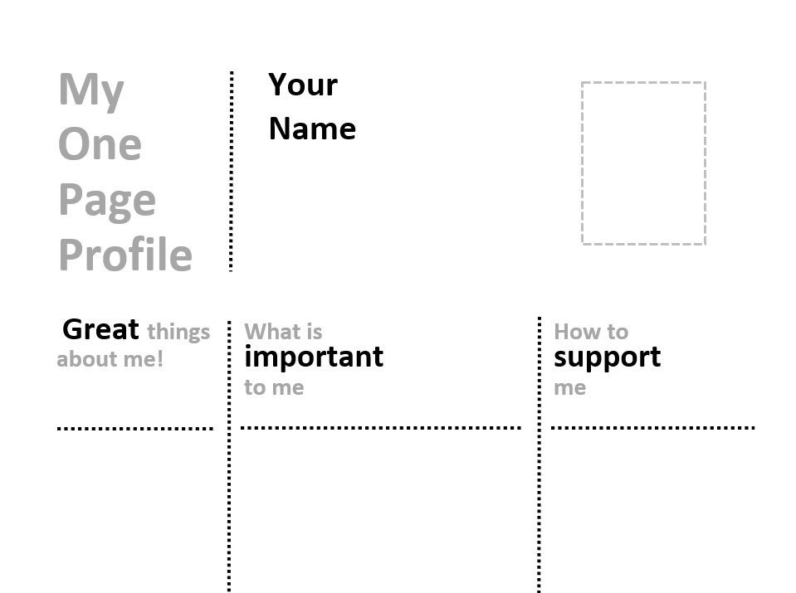
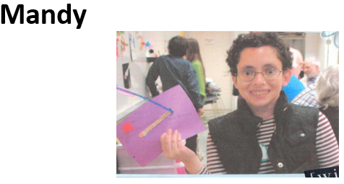
Let’s Start One-Page Profiles Together!!!
We will target a few important areas for a one-page profile. I will share the subject along with some prompts to get you thinking.
You can do this for yourself or a family member of someone whom you support!
Grab a pen/paper Or use the template I share in the chat to start adding your thoughts.
This is your perspective, so to complete this one-page profile, you will need to get input from others (especially the individual being supported!)

Slide 7
Great Things About Me!!
What do you like an admire about yourself, your family member or the person you support?
What do you appreciate about them?
Focus on positive qualities and what the individual is good at!

Slide 8
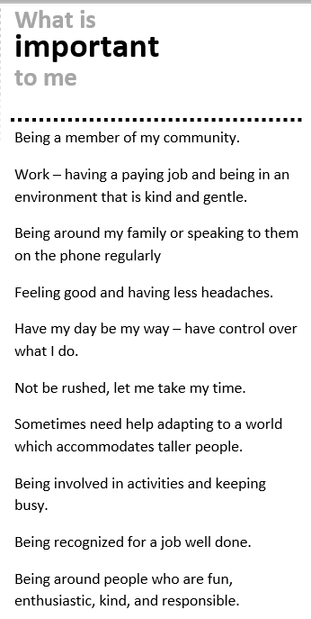
What Is Important To Me?
From your point of view, what are the things that are most important to you, your family member or the person you support?
Who are the people that are most important?
What hobbies or interests does the person like to do to make them happy
What routines are important?
What are some things that should be avoided.
What are things that he or she has to do (and things he or she needs to have) if he/she is going to be happy?

Slide 9
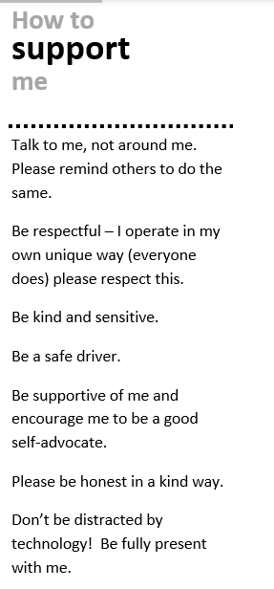
How to Support Me!
If the person is going to be healthy and safe, what do others need to know?
What do others need to do?
How does the person need to be supported at home, at work or in the community?
What makes the person feel better when he/she is stressed or unhappy?

Slide 10
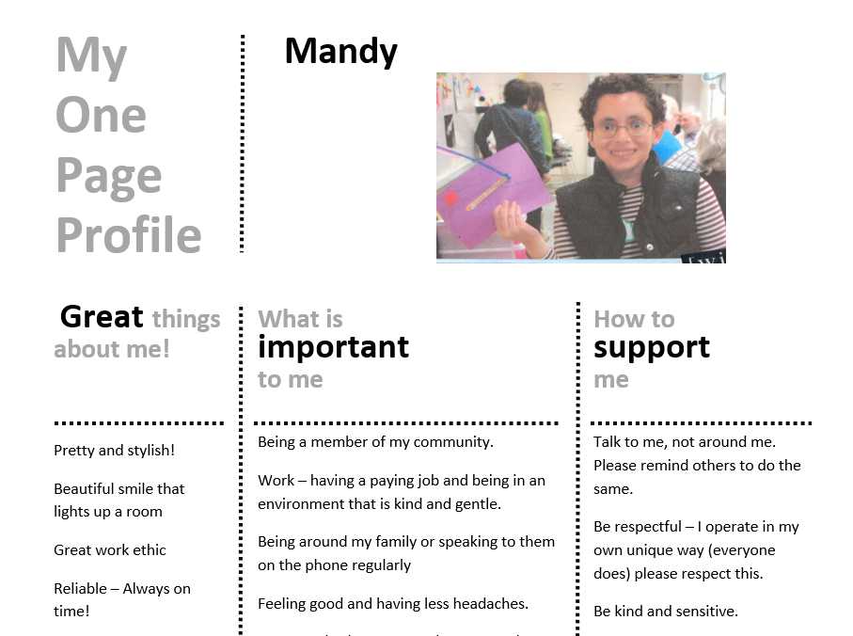

Slide 11
Variety of One-Page Profiles
Each profile should be unique and different.
Feel free to get creative or ask someone who is creative to help.
You can add a variety of other fields based on what the profile might be used for.
I like “Qualities of Those Who Best Support Me” which can be used to help capture qualities of staff that you are seeking to hire. Some questions to consider - What are the characteristics of people who support your child? If you were going to pick a person to work with your child, what would you look for? What do the people that he or she likes to work with have in common? Have there been people that he or she couldn’t work with? What do they have in common?

Slide 12
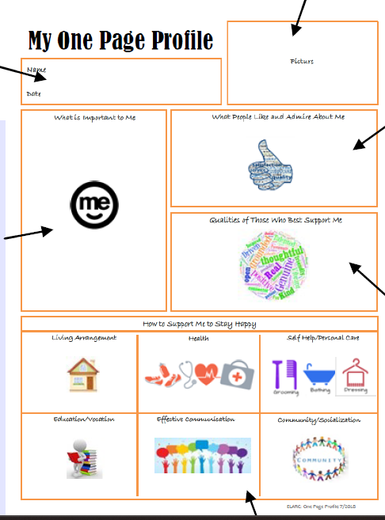

Slide 14
Learn More!
Helen Sanderson Associates – https://helensandersonassociates.com/
Person Centered Thinking/Planning/Essential Lifestyle Planning –
https://www.dhs.state.mn.us/main/groups/county_access/documents/pub/dhs16_191036.pdf

