Slide 1
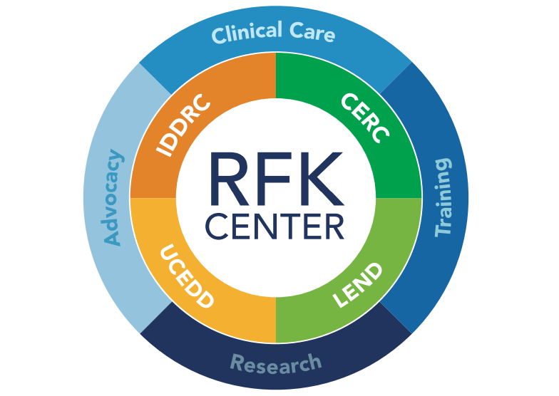
Infusing Intellectual and Developmental Disability Curriculum in Medical School DD Councils of the 5 Boroughs Conference: Aging in the Intellectual/Developmental Disabilities Community July 18, 2023
Vincent Siasoco, MD, MBA
Family Medicine Physician
Assistant Professor, Department of Family Medicine and Pediatrics
Albert Einstein College of Medicine at Montefiore Medical Center

Slide 2
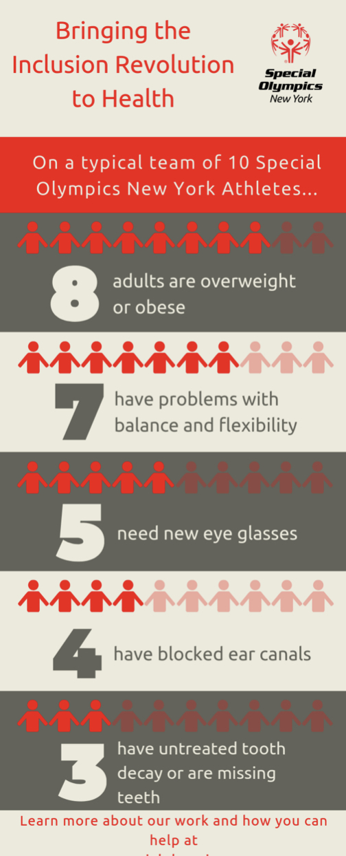
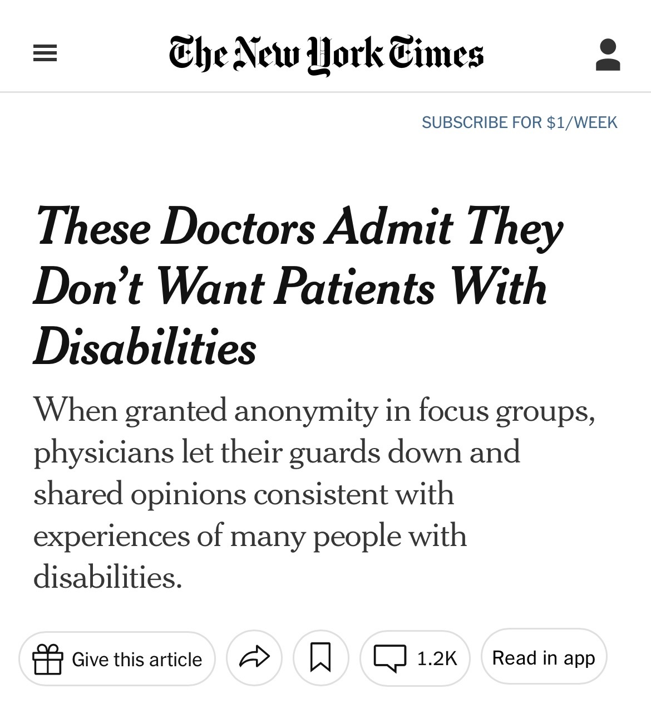
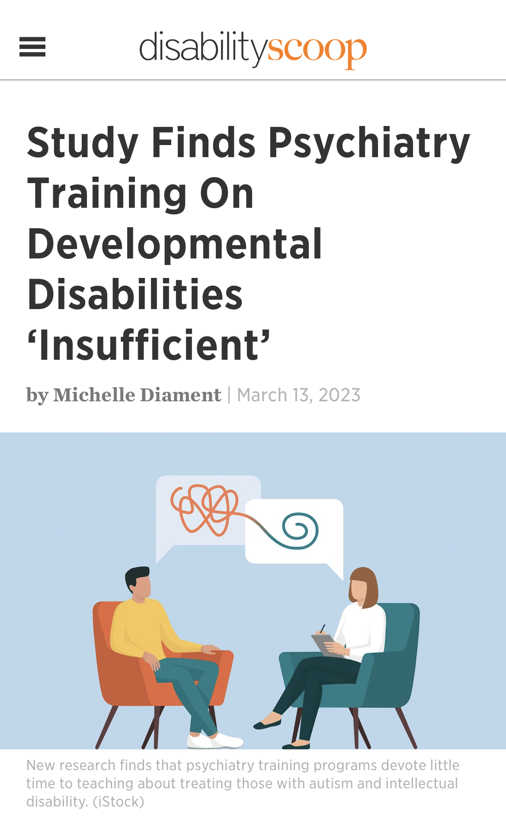
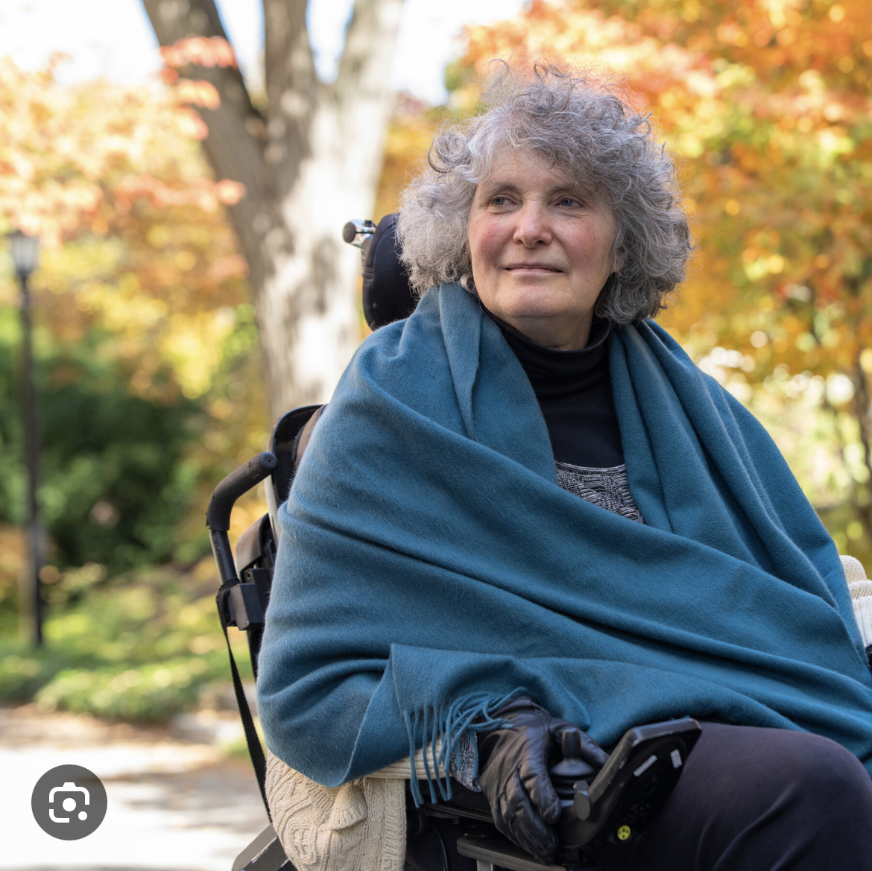
Disparities In Healthcare

Slide 3
Infusing Intellectual and Developmental Disability Curriculum in Medical School
AY2017 – 2018
2nd Year Medical School Course: Nervous System and Human Behavior
-IDD curriculum begins.
AY2018 – 2019
2nd Year Medical School Course: Nervous System and Human Behavior and Introduction to Clinical Skills Courses.
AY2019 – 2020
2nd Year Medical School Course: Nervous System and Human Behavior and Introduction to Clinical Skills Courses
-Einstein is awarded grant funding through the AADMD National Curriculum Initiative in Developmental Medicine (NCIDM) which is now called NICHE.
AY2020 – 2021
Einstein continues to implement the NCIDM Project into the 2nd year NSHB curriculum remotely due to COVID 19 Pandemic.

Slide 4
AY2020 – 2021 -The AADMD Student Chapter at Einstein is established. AY2021 – 2022 -Special Olympics reopens in-person Games and the Healthy Athletes Screening.
Student Chapter

Slide 5
Infusing Intellectual and Developmental Disability Curriculum in Medical School
AY2021 – 2022
2nd Year Medical School Course: Transition To Clerkship Course.
AY2022 – 2023
1st Year Medical School Course: Service-Learning Program.
-External Partnerships - ADAPT Community Network Bronx Day Program.
3rd Year Medical School Curriculum: Primary Care Clerkship Clinical Rotations
-Rose F. Kennedy Adult Clinic
-ADAPT Community Network Bronx Clinic

Slide 6
THANK YOU
Vincent Siasoco, MD, MBA

