Slide 1
Autism Spectrum Disorder and Aging.
Lori Volpe, Ph.D.
Senior Coordinator of Autism Services

Slide 2
Autism Spectrum Disorder
Autism Spectrum Disorder (ASD) is a neurodevelopmental disorder.
It impacts the acquisition and use of communication and social skills, and display of restricted, repetitive patterns of behavior.
ASD is a lifelong condition. People with ASD will grow, learn and develop when provided with appropriate education and support.
As a result of advances in medical care, people are living longer than ever before in recorded history. There has been a growing interest in maintaining/ improving the quality of life for all seniors, including those with ASD.
ASD, as a formal diagnosis, is relatively new (DSM-III, 1980) so the focus on aging and ASD has become a more recent area of investigation.
Donald Triplett
1933-2023 (age 89)
First person to be
diagnosed with autism

Slide 3
Myth…..
The challenges of ASD get worse with age.
FALSE
Just like the neurotypical population, the aging trajectory for individuals with ASD affect people differently. However, the co-occurrence of the issues common in aging along with the characteristics of ASD may require different approaches to assist the person in maintaining quality of life.

Slide 4
Typical Changes in Aging
Changes in cardiovascular system (increased risk for hypertension and associated disorders)
Changes in bones, joints and muscles.
Changes in digestive system
Changes in bladder and urinary tract
Cognitive changes (decreased memory and thinking skills)
Changes in social/ emotional functioning/ social networks
Changes in hearing and sight
Changes in oral health
Changes in the texture and elasticity of skin
Changes in weight
Changes in sexual functioning

Slide 5
Impact of ASD diagnosis on Aging
Older adults with ASD may or may not have ever had a formal ASD diagnosis. Many may not have been diagnosed until adulthood, when they had challenges attaining the level of independence expected of adults (i.e., vocational success despite having achieved academically; independent living) or had a child who received a diagnosis. Many may have been mis- or incompletely diagnosed, leading to inappropriate treatments/ supports.
If one assumes that the prevalence rate of autism has increased in the past three decades, then the estimated prevalence rate before the 1980s was 1 in 2,000 children. The 2013 U.S. census reports 63 million people who are age 60 and older. This would amount to 31,500 seniors with autism in the U.S. Using a less conservative statistical approach, if one assumes that the prevalence rate of autism has always been 1 in 68, this would total to 926,500. In either case, the main point is that there are tens of thousands or possibly even hundreds of thousands of people on the autism spectrum in their senior years. If one were to harbor an educated guess, there are approximately a half-million seniors on the autism spectrum in the U.S. (Edelson, Stephen M, & Bauman, Margaret A. (2022, July 12). Aging in autism: A call to action. Autism Research Institute. https://autism.org/aging-autism-call-to-action/)

Slide 6
Impact of ASD diagnosis on Aging
Many adults on the spectrum live with their parents. These parents are also aging, and themselves are in declining health and in need of support, unable to continue to provide the level of support their adult child may need. This creates an increased need for supportive living environments and day/ respite programs.
A significant percentage of these families have not done future planning for their adult child. Nor are they connected to a formal service system. It is often the unplanned for crisis within the family, that precipitates looking for services and supports.
Survey research has revealed that family support of their autistic child/ sibling can be much more involved and time consuming than caring for a neurotypical aging parent.

Slide 7
Impact of ASD diagnosis on Aging
According to the Family and Individual Needs for Disability Supports (FINDS) survey, conducted by The Arc in collaboration with the University of Minnesota, 52% of caregivers spend at least 40 hours a week supporting their family member with I/DD—nearly double what children caring for aging parents and spouses reported in a recent National Alliance for Caregiving/AARP study.
The FINDS survey found that most caregivers have serious concerns about the future—for themselves and for their son or daughter with I/DD. The most common concerns were that once the caregiver dies or is no longer able to provide care:
The quality of support for the person with I/DD will go down (89%).
The person with I/DD will not have friends or will be socially isolated (78%).
No one else will provide support for the family member with I/DD (78%).
The person with I/DD will have to live somewhere he or she does not want to live, such as a nursing home or institution (76%).
The family member with I/DD will see his or her health deteriorate (74%).
The person with I/DD will be abused or neglected (73.0%).
The person with I/DD will be financially exploited (62%).
Mahar, E., Sladen, J., & Nitsch, C. (n.d.). Older parents as caregivers: Grantmakers in aging. Older Parents as Caregivers | Grantmakers in Aging. https://www.giaging.org/issues/older-caregivers-of-people-with-intellectual-developmental-disabilities/

Slide 8
Impact of ASD diagnosis on Aging
Studies of aging in autism will be important not only to plan appropriate services, but also to shed light on the full developmental trajectory of this neurodevelopmental condition, and perhaps provide clues to neuropathology and etiology. (Happé, F. & Charlton, R.A. Aging in Autism Spectrum Disorders: A Mini-Review. Gerontology 2012;58:70–78)
Investigations have looked at how physical health and aging (measured with self-reported questions and decline in multiple biological measures) were related to autistic traits (measured with a questionnaire, at age 45). It was found that higher autistic traits were associated with poorer reports of physical health, and a faster pace of aging. This suggests that both those with autism and those with higher autistic traits may be more likely to experience poorer health outcomes. (Mason D, Ronald A, Ambler A, Caspi A, Houts R, Poulton R, Ramrakha S, Wertz J, Moffitt TE, Happé F. Autistic traits are associated with faster pace of aging: Evidence from the Dunedin study at age 45. Autism Res. 2021 Aug;14(8):1684-1694.)

Slide 9
ASD and Psychiatric Disorders
Comorbid psychiatric disorders are higher for autistic people than in the general population. Life-time rates for individuals with ASD:
Mood Disorders 53%
Anxiety 50%
Attention Deficit Hyperactivity Disorder (ADHD) 43%
Eating Disorder 5%
*Anxiety and Depression are particularly prevalent but may or may not present with “typical” symptomology.

Slide 10
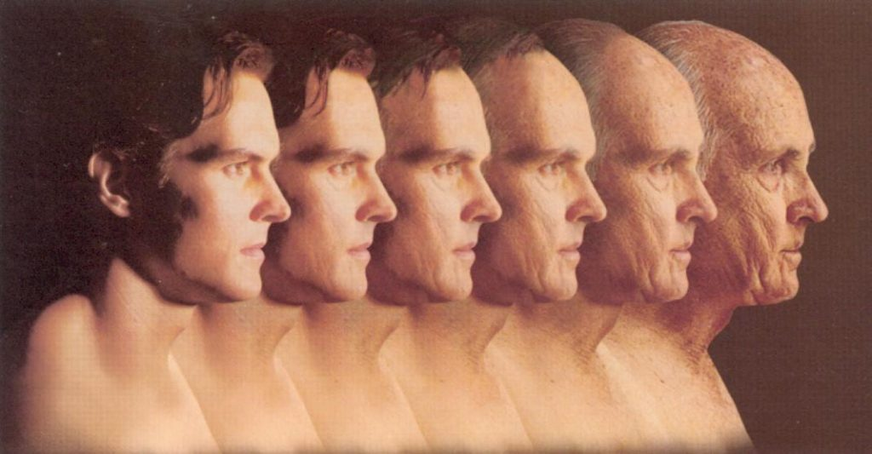
Aging is all about change…..
Change is something adverse to most people with ASD….

Slide 11
Supporting the Senior with ASD
Appreciate the person’s gifts and skills. They have a lifetime of experiences, talents and expertise, which when shared with others, fosters feeling of relevance and connectedness.
Prepare the person for the eventual loss of skills. Help support their understanding that it is a natural part of aging for sight and hearing to become impaired. Balance and flexibility may be diminished, effecting mobility.
While preparing for declining health may be challenging, as we do not know what the future holds for any one individual, we can support them in developing a healthy life-style and positive attitude. Doing so will support the maintenance of as good health as possible.

Slide 12
Supporting the Senior with ASD
As the person with ASD may become more rigid, those supporting them will need to increase their own willingness to be flexible in our interactions and plans.
Give the person more time to process and respond to communication. Their auditory processing may be further impacted by hearing loss, as they age. The use of visual supports (i.e., written and/ or pictural) may be helpful.
Before judging “misbehavior” as intentionally negative, reflect on the confusion and anxiety the person with ASD may be experiencing surrounding the changes in their life.
Proactively, develop coping resources for the individual with ASD. Maintain a positive and supportive demeanor.

Slide 13
Supporting the Senior with ASD
As a result of sensory processing differences, the person with ASD may not recognize subtle bodily changes and their realization may be sudden and jarring. For example, they may not recognize the slow loss of hearing until one day when they panic and/ or appear “paranoid” about what others may be doing or saying about them.
The person with ASD may have difficulty explaining to those who support them and/ or medical personnel what they are feeling physically/ emotionally. They also may face challenges waiting for appointments so thoughtful scheduling can be helpful. Also, having visuals available to support the person’s receptive and expressive communication during the visit. It is also somewhat unclear if autistic individuals experience medical issues, and the treatments for them, the same or differently than neurotypical people.
When hospitalized, autistic people may develop, what is referred to as “hospital psychosis”. They may become disoriented and paranoid in an unfamiliar environment. They may become argumentative, refuse treatment and they may set their sights on escape, so elopement safeguards may need to be implemented.

Slide 14
Supporting the Senior with ASD
Neurocognitive functioning declines with age. The challenges increase for the person with ASD, for whom executive functioning, local-global processing, and episodic memory are especially difficult. This decline is exacerbated when the person has a comorbid intellectual disability.
Supports (as needed):
Organized, labeled environment making it easier to people find what they want/ need.
Visuals to support daily routines (ex. self- care skills, household chores, etc.).
Creation of daily schedules to provide structure and predictability.
Refrain from challenging individuals on their memory for events/ "facts" in their lives. Be supportive and redirect to an alternate conversation, if necessary.

Slide 15
Think Tank on Aging and Autism
In October of 2017, an international Think Tank was assembled. Participants were autistic adults, clinicians, researchers, and service providers.
Their objectives were:
To bring together autistic individuals, researchers, clinicians and policy makers to identify individual and contextual factors facing the aging autistic population and their families;
To promote a multi-role and inter-professional approach to identifying the unmet physical, medical, social and service needs experienced by aging autistic individuals and their families;
To facilitate international networking and collaboration around common priorities and to advance research, knowledge, and solutions for issues related to aging in those on the autism spectrum.

Slide 16
Think Tank Considerations for Optimal Support
Increase Awareness and Understanding
Publicly funded postsecondary education and professional training are needed to support autistic adults in achieving employment and career goals, and to attain and retain meaningful positions in the workforce.
Positive attitudes and flexible business environments are needed to create more accessible and sustainable jobs.
More community-based solutions and interventions to redress social isolation and promote inclusivity. More effective advocacy, with regard to supporting life course decisions and opportunities for both individuals on the spectrum and their care providers.
Caregivers employed by retirement homes and/or other long-term care facilities may be ill-prepared to accommodate the needs of the autistic population. Thus, specialized training programs are needed for staff in residential care facilities as well as the development of alternatives to facility-based care. Much can be learned from studying inclusive multi-generational and trans-generational housing alternatives, which are gradually becoming popular in the United States and various other world regions.

Slide 17
Think Tank Considerations for Optimal Support
Autistic individuals raised concerns in approaching old age variably included: (1) maintaining an independent lifestyle, (2) self-identifying health issues prior to requiring medical intervention, (3) learning how to (and being able to) find appropriate support when needed, (4) remembering to take medications. Those who experience anxiety and/or depression were concerned with how these challenges might change as they age, (5) apprehension about managing post-retirement life, and the associated loss of work-related colleagues and friends.
All acknowledged the need for more adult-based research
Need for recruitment of a relatively large sample size of seniors on the spectrum.
Need for large- scale longitudinal studies evaluating multiple parameters including mental health, physical health and quality of life, with data collected from autistic adults and their caregivers. Also, the collection of biological samples including brain tissue.

Slide 18
Think Tank Considerations for Optimal Support
Successful Program Models
The Ontario (Canada) Working Group on Mental Health with ASD (https ://www.porticonet work.ca/web/adult-asd) has developed strategic plans to increase awareness about mental health needs of autistic adults among physicians.
The Redpath Centre in Canada (https://redpathcentre.ca/) provides various services for autistic individuals and other neurodevelopmental conditions throughout the lifespan. They also conduct research, educate stakeholders and advocate for system change.
First Place Arizona (USA) (https://www.firstplaceaz.org/)offers supportive housing which includes a residential transition program.
Community-based Microboard systems (https ://www.velacanada.org/vela-micro board s) direct support and manage funding at the individual level. This also includes advocacy for an individual’s needs in the community.
The Star Raft model (USA) (https://thestarraft.com/) is a tool that helps build and sustain family-friendly, person-centered support networks
Edelson, S. M., Nicholas, D. B., Stoddart, K. P., Bauman, M. B., Mawlam, L., Lawson, W. B., Jose, C., Morris, R., & Wright, S. D. (2020). Strategies for research, practice, and policy for autism in later life: A report from a think tank on aging and autism. Journal of Autism and Developmental Disorders, 51(1), 382–390. https://doi.org/10.1007/s10803-020-04514-3

Slide 19
Summary
Aging is a process that follows different paths for different people. Some aspects of functioning may decline slowly, while others may deteriorate rapidly (especially following a medical crisis like a stroke, etc.).
Having frank and open discussions with the autistic adult and their family (caregivers) about the individual’s wants and needs as they age, and how those desires may be accomplished.
Research has shown that the aging process in autistic people happens, on average, at a more rapid pace than the typically developing population. This is exacerbated by the intensity of autistic symptomology and comorbid disorders (ex. intellectual disability and/or other psychiatric/ medical conditions). But more research is needed to better understand the aging process for autistics.
Be as proactive as possible in helping individuals maintain their health in their younger years so it becomes a positive routine (i.e., encourage regular exercise, healthy diet, preventative health care, etc.). People with ASD tend to be routine bound, and it is most effective to set a good routine to begin with than to have to establish a new one.
Have a variety of visual supports (pictorial and/ or printed) available so as memory/ skills fade, reference are in place to maintain independence.
Be empathetic and supportive. The progression of aging can be disarming to many people, and it may be that much more so for the autistic person for whom processing the world around them is generally more challenging.

