Slide 1
Aging and Autism: Understanding and Planning for the Needs of Older Adults with ASD
Presented by:
Joanne Gerenser, Ph.D.
Randy Horowitz, M.S.Ed., S.A.S.
Annmarie Itgen M.S.Ed, BCBA, LBA
At: The Developmental Disabilities Councils of the 5 Boroughs Virtual Conference
July 18, 2023

Slide 2
One of the most complicated and worrisome issues facing families and providers of individuals with autism is providing long-term living and learning opportunities as the participants age

Slide 3
Issues in Aging: General Population
Engagement and purpose- Helping older adults get and stay meaningfully engaged is critical for their health and the health of our communities.
Mobility and movement- Remaining safe and mobile are top priorities for older adults.
Daily living and lifestyle - One third of people over 65 need assistance with at least one activity of daily living (e.g. eating, bathing, dressing).
Caregiving-
Families need support and training
On the professional side, staff shortages and quality of care are huge concerns
Care coordination- Two-thirds of seniors have at least two chronic conditions.
Brain health - 10% of adults 65 and over develop Alzheimer’s disease
and this % doubles every five years after that.

Slide 4
The impact of aging can be much more traumatic and/or challenging for the individual with ASD due to:
less flexibility (physically and mentally),
more sensory issues,
and decreasing social skills.
ASD= Autism Spectrum Disorder

Slide 5
Aging Individuals with Autism
Communication and interaction- It is common for seniors with ASD to have difficulty explaining states of health. For example, they may not tell you they are experiencing stiff joints, leg cramps, or heart arrhythmia.
This will require skilled observation abilities in the staff who support aging adults on the spectrum
Language and learning characteristics – “skill retention”
Often associated with co-occurring sensory, physical, and mental health conditions (e.g., four times as likely to suffer gastrointestinal problems and more than twice as likely to have a psychiatric diagnosis than the general population).

Slide 6
Aging Individuals with Autism
Although they are at an older age, they may still be "stuck" in the interests and behaviors of a younger era in their lives, such as liking and even obsessing on childish music, movies, toys/games
Aggression / self injury
Problems with accessibility to services of all types (e.g., residential/housing problems)
Lack of appropriately trained support personnel
Lack of a lifelong learning environment

Slide 7
Aging in Individuals with Autism
More than half of people with ASD have four or more co-occurring conditions
Epilepsy
Gastrointestinal conditions
OCD
Depression

Slide 8
Aging in Individuals with Autism
Although onset of aging effects are gradual…a person with ASD may experience it as sudden…for example, not realizing they are losing their hearing…until they do realize it..
Diminished hearing and sight..aches and pains can lead to a grumpy disposition

Slide 9
Aging in Individuals with Autism
Individuals with Level 3 Autism are 2.5 times more likely to die early than NT peers
Predictors of early morbidity include:
Fair to poor health was # 1 predictor
Long term medication use
Limited self sufficiency in ADL skills

Slide 10
In addition, most face a future with inadequate financial support, a broader range of general health problems than previously stated, and no longer having their parents to take care of them and voice their needs
(Mukaetova-Ladinska et al., 2011).

Slide 11
Individuals with Autism on SI by Age
There are about 45 provider agencies on SI serving thousands of adults with autism and developmental disabilities
Preliminary data indicate that each agency’s current population of seniors over 55 years old:
Ranges from 4%- 48%.
That’s a current average of 22% of agency’s combined total population being over 55 years old
And this number is rising

Slide 12
In Summary
Aging individuals with ASD are in need of a high level of support
In light of the rapidly growing geriatric population, coupled with the considerable lack of societal awareness of the realities of aging in ASD, now is the time for our community to investigate and plan for their needs

Slide 13
The Challenges
Most individuals with significant autism (Level 3) will not be able to be adequately supported in traditional senior centers or environments due to:
High levels of challenging behaviors
Sensory issues
Communication deficits

Slide 14
The Challenges
Many individuals with significant autism who will not longer be able to be adequately supported in traditional adult day programs for people with ASD due to:
Ongoing health issues
Mobility issues
Program structure

Slide 15
The Challenges
There is still so much that needs to be investigated to better understand the impact of aging on people with ASD.
We do know that there is a greater impact of health problems in people with ASD due to:
Lack of reporting of health issues resulting in delayed or no treatment
Far less preventative care
Long history of medication usage

Slide 16
The Challenges
We do know that advanced age is a risk factor for Neuro-Cognitive Disorder (NCD)
Other risk factors include:
Seizure disorder
Depression
Sensory dysfunction
Metabolic disorders
Given the prevalence of the above in ASD, it is likely that they are then predisposed to develop NCD.

Slide 17
People Receiving OPWDD Medicaid Services
Sixty percent (60%) of those served by OPWDD are adults ages 21 to 64

Slide 18
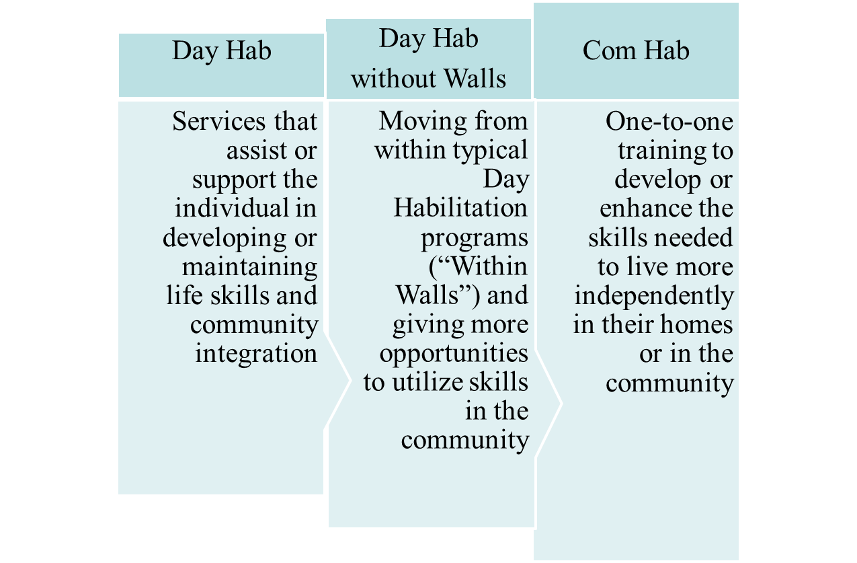
Current Adult Day Programs Models
A big focus
on community integration

Slide 19
Continuum of Care
The primary model for day hab over the past decade has been day hab without walls.
The problem is that as individuals with ASD age, many simply don’t want to go out every day into the community.
In many cases, the demands of a without walls model can lead to increased problem behavior.

Slide 20
And…
At Eden II, even our lowest support needs individuals require a “home base”
to plan their day, and
to have time to re-group in between activities.
In addition, our staff also need a place for breaks and to attend trainings as needed and required

Slide 21
Continuum of Care
Currently there are no adult day programs specifically designed to meet the needs of seniors with autism
But there is guidance and research that describe components of effective / quality autism programs

Slide 22
(Some) Components of effective/quality autism programs
Interdisciplinary Support
Medical team
Speech language pathology
Psychiatry and/or psychology
Occupational and/or physical therapy
Public health
Social work
Experts in aging
Highly supportive learning/habilitation environments
Instructional/Habilitation Planning
Instructional/Habilitation Strategies

Slide 23
Components of Effective Programs… in general…
An effective program / environment would be:
Attractive & welcoming
Demand free
Staffed by specialists with expertise in the field of autism and aging
Focused on quality of life programming
https://www.ncbi.nlm.nih.gov/pmc/articles/PMC6559228/

Slide 24
More specifically….
Facilities modifications
ADA modifications such as ramps and other needs as people become less ambulatory
Furniture / fixtures
Balance comfort and beauty with extreme safety security and durability
More center based options (let’s be careful about this narrative)
Notes:
24

Slide 25
Components of effective autism programs…continued
Staff training
Staff (provider agencies and OPWDD) need training in the aging process and how this may look in people with ASD
More medical support and training will be essential so staff are better prepared to deal with issues such as:
Diabetes
Vision and hearing loss
Mobility issues
Heart disease
Dementia
Depression

Slide 26
Functional Approach to Challenging Behavior
Modifying antecedent or setting events.
Implementing consequence strategies.
Using highly-preferred materials or activities as teaching materials or reinforcers.
Alternating preferred and non-preferred activities.
Prompting or modeling appropriate responses with gradual prompt fading.

Slide 27
Options
Increased collaboration with elder care programs
Modification to funding to allow for participants to be supported in adult day centers (with appropriate staff)
Modifications to funding to allow participants, who have been moved to nursing homes, the opportunity to attend adult day programs with appropriate staff

Slide 28
Options
Integrated Specialized Senior Center
Develop a specialized senior day program
Further specialize at different sites
Non ambulatory/medically fragile
Challenging behaviors with or without dementia

Slide 29
Integrated Specialized Senior Center
Participant can attend program as much or as little as desired
Typical aging adults can attend the program

Slide 30
Annmarie’s Experiences
Senior center activities
planning and building strategic partnerships to develop options that will meet the needs of aging individuals with autism.
Focus on preference and choice
Building a robust schedule of meaningful leisure, health, wellness and nutrition activities

Slide 31
Integrated Senior Center
There is currently no program available on Staten Island for individuals with severe autism who are aging
Eden II’s adult program opened in 1982 and has a number of participants in their 50s and 60s.
And this number is rising
Eden II Programs

Slide 32
We want to share our vision for a
Senior Center for the Autism Community
As we strive to fulfill our mission:
to support people with ASD through their lifespan, and
to be recognized as a model of excellence in the community for meeting the needs of seniors with ASD

Slide 33
Health Outcomes
Community Outcomes

Slide 34
One to one meals
Visual schedules
Direct Instruction
Sensitive to selectivity & sensory issues

Slide 35
Community Outcome | Senior Center Activity | Specialized Activity for Individuals with ASD
Highest Level of Community Involvement | Members volunteer at the center Volunteer teams for community service projects Matching services for individual volunteer interests
Resource Center for Aging in Place | Access to opportunities for socialization and mental stimulation Access to medical screenings and preventive care Access to transportation to/from medical appointments
Community Continuum of Care | Health screening Flu and other vaccines Chronic disease education, prevention, management Targeted exercise groups Fall prevention
Be open minded about interests
and be creative with age appropriate interests
Pair with special SR
Discrimination Training
Minimize Transitions

Slide 36
Integrated Senior Center Next Steps
Develop Advisory Board Comprised of Three Major Area:
Autism (individuals, families, support staff)
Aging (experts)
Medical professionals
Create plans to have Eden II access the center
The majority of funding will come from OPWDD
Other funding will come from grants and philanthropy
Identify community partners
Community Agency for Senior Citizens (CASC)
Jewish Community Center (JCC)
Supreme Chocolatiers

Slide 37
Advisory Board compromised of three areas of focus:
Autism (individuals, families, support staff)
Aging
Medical
Plan is to have Eden II use the Senior Center
The majority of funding will come from OPWDD
Other funding will come from grants and philanthropy
Potential collaborations include:
Community Agency for Senior Citizens (CASC)
Jewish Community Center (JCC)
Supreme Chocolatiers
Eden II Programs

Slide 38
Our nation’s intermediate care and skilled nursing facilities are not equipped or
appropriately staffed to manage the growing number of admissions of people with language, communication, socialization, and behavioral issues seen in ASD. It will be important that adequate resources are available, particularly in personnel and training, so that individuals
can continue to function at the requisite “highest practicable level.”
Pamela Smith (2012)

Slide 39
References
Charlton, R. (2017, September 5). Research autism and ageing. National Autistic Society. https://www.autism.org.uk/advice-and-guidance/professional-practice/research-ageing
Crabtree, J. , Hickey, A. (2018, February 2). Autism and Ageing: Loneliness and Isolation, National Autistic. https://autism.org.uk/advice-and-guidance/professional-practice/ageing-loneliness
Donvan, J, & Zucker, C (2016). In a Different Key: The Story of Autism. Crown Publishers.
Gillot, A., Standen, P.J., (2007). Levels of anxiety and sources of stress in adults with autism. Journal of Intellectual Disabilities 11 (4), 359-70. https://doi.org/10.1177/1744629507083585
Gottlieb, E. (2015). Adult, Autistic and Ignored. The New York Times, Opinion.
Halladay, A. (2018, December 23). A 2018 year of review of scientific research. Autism Science Foundation. https://Autism science foundation.org/year-end-summary-2018
Howlin P. (2021). Adults with autism: Changes in understanding since DSM-111. Journal of autism and developmental disorders, 51(12), 4291–4308. https://doi.org/10.1007/s10803-020-04847-z
Mazurek M. O. (2014). Loneliness, friendship, and well-being in adults with autism spectrum disorders. Autism : the international journal of research and practice, 18(3), 223–232. https://doi.org/10.1177/1362361312474121
Robison, J. (2018, September 2). Life, love and happiness for autistic adults-What happens to autistic people as they age? Psychology Today. https://www.psychologytoday.com/us/blog/my-life-aspergers/201809/life-love-and-happiness-autistic-adults
Sacks, O., Silberman, S. (2013) Neuro Tribes: The Legacy of Autism and the Future of Neurodiversity. Penguin Books.
Schall, C., Smith, M., & Wehman, P (2009). Autism and the transition to adulthood: Success beyond the classroom. Brookes.
Vaillancourt, M. (2016, April 2). It is no surprise that people with autism have a low life expectancy. Independent Minds. https://www.independent.co.uk/voices/it-s-no-surprise-that-people-with-autism-have-a-low-life-expectancy-our-needs-as-adults-are-being-ignored-a6964751.html

Slide 40
Thank You
www.eden2.org
Eden II Programs

