Slide 1
What Exactly is Creating Blue Space: Towards Co-Created Partnerships with Individuals and/or their Families and Allies
Hanns Meissner, PhD hannsm@verizon.net
Queens Council on Developmental Disabilities-
Self-Direction/Self-Determination Committee
March 23, 2023

Slide 2
What We Are Talking About Today
How services have changed and evolved for persons with disabilities.
Explore the factors that have influenced the changes.
How we need to create the conditions (inside of our self and our agency) for blue space to bring forth innovative social actions.
What this means for individuals, their family and allies as well as providers and practitioners? What can we do differently, and what do we want to retain going forward?

Slide 3
Critical Questions for Allies and Partners in the Quest for Inclusion and Citizenship for All
Challenging Question 1. How can we challenge the practice of the “grouping” together of a historically devalued group of people- in ways that help to grow inclusive, connected communities?
Challenging Question 2. How can we shift from a culture of service provision to a culture of contribution, connection and purpose?
Challenging Question 3. How can we enable each other to discover, appreciate and share our innate gifts, especially those for whom the world has said, “you have no gifts or value.”

Slide 4
The Search for Good Form
Overtime, the shape and form of services and supports for people who need assistance has evolved. The forms of services and supports can assume a good form or possibly take on a dysfunctional expression.
This Search for Good Form applies to the structures, processes and practices of services. More importantly it considers what role we assume with people who need assistance.
As such, good form has both a utilitarian (instrumental) function as well as a aesthetic (relational) aspect.
When traditional institutional service forms no longer work for people, both utility and aesthetics demand the invention of new support models.

Slide 5
Your Learning Journey – Deepening Capacity as an Instrument of Change in Service of Social Innovation

Slide 6
Our Assumptions About People with Disabilities
People with Disabilities are Tragic & Vulnerable
People with Disabilities are Consumers with Clinical Needs
People with Disabilities are Individuals with Capacities
People with Disabilities are Citizens
Community Resources
Our Design Responses
Create Special Institutions
Coordinate Care
Person-Centered Supports
The Outcomes that Emerge From Our Care and Support Designs
Personal Care, Activity, Housing
Plan of Coordinated Care, with Appropriate Levels of Service, Customer Satisfaction
Individualized Supports leading to job, home & relationship
Valued Roles – A Life of Distinction
Notes:
Taking each care and service model – we see that our assumptions about disabilities lead us to certain ways of designing services (including service and treatments pathways and how we see our roles and relationships) – ultimately this leads to certain outcomes that are achieviable. It also suggests that certain designs cannot achieve other outcomes. This is apparent when we wonder why we keep getting outcomes we don’t want.

Slide 7
We need mechanisms to coordinate all the services for needy consumers
We need circles to connect a person’s unique qualities to a community
We need communities with capacities to socially include all its members
We need institutions to care for special populations
Emerging Support Models Reflect Building of
Individual & Relational Capacity & Our Striving for the
Wholeness of Our Communities
Our Care Models – Are Singularly Focused on Structures And Systems
Emerging Support Models Reflect Our Striving
for the Wholeness of Our Communities
Notes:
The challenge to support people with disabilities, in shape and form, is not a recent one. Over the years our way of thinking about supports have evolved. This slide offers the central focus of the major four ways services and supports have taken shape.

Slide 8
The Four Primary Forms that DD Services Have Assumed
Over the Past 60 Years
Institutional
Care
Managed Care
Integrative Supports
Community Supports

Slide 9
 | Institutional Care | Managed Care | Integrative Supports | Community Supports
Organizing Principle
Individual-Professional Relationship
Individual-Service Experience
Focus of Innovation and How Something New is Created
Degree and Type of Complexity or How we make meaning
Organizational Culture – How Power Shows Up
Source of Legitimizing Service or Supports Activity
Outcomes of Individuals
Leadership Orientation
Readiness for Valued Role and Employment | Not Ready | Assessed Readiness | Employment First | Employment for All

Slide 12
An Organizational Narrative
I have written a book called Creating Blue Space. It is a story about caring people dealing with one of the most important challenges facing the community and people with developmental disabilities:
How to reshape an organization with deep investments in serving people in groups to supporting individuals in self-directed arrangements as citizens of their communities?
Notes:
I suspect that I have been invited to speak to you today because my organization and I have been on a journey that is very similar to the one you are experiencing. For the last 40 years I have struggled to find the best way to support individuals with disabilities. The answer to this questions has morphed and evolved into different forms and shapes over the year.
At the core of the journey is the question on this slide…

Slide 13

In the eye of the hurricane the sky is blue and birds can fly there without suffering harm. The eye of the hurricane is in the very middle of destructive power, and that power is always near, surrounding that blue beauty and threatening to invade it…
In a world of moral hurricanes some people can and do carve out rather large ethical spaces. In a natural world and a social world swirling in cruelty and love, we can make room. We who are not pure ethical beings can push away the choking circle of brute force that is around and within us. We may not be able to push it far away, but when we have made as much room as we can, we may know a blue peace that the storm does not know.
–Philip Hallie

Slide 14
Creating Blue Space to nurture our interior condition and an intention to hold space for authentic person-centered work
Viral Pandemic
Funding Cuts
Prejudice
Deficiency-Based
Assumptions About
Disability
Overregulation
Segregation
Poverty
Workforce Crisis
Abuse
Marginalization

Slide 15

Freedom to…
…build relationships
…discover new possibilities
…try new ways & learn
A
little bit more
Blue Space

Slide 16
Creating Blue Space – A Social Container and an Interior Condition that Fosters
The Opening of Our Mind – Curiosity
The Opening of Our Heart – Compassion
The Opening of Will – Courage
The Promotion of Generative Action – Implementing Innovative Support Solutions
Notes:
Further defining blue space metaphorically refers to>>>

Slide 17
What is Our Highest Purpose?

Slide 18
Relational Shifts- the Holy Grail of Social Change
Assessing the Degree of Individual Choice and Engagement in the Designing, Implementing and Experiencing of Support and Services.
Notice How an Individual’s Choice and Engagement Expands as Models of Care Morph to Supports
The Key to Evolving from Care to Support Lie with our Depth of Listening and Attending
From Deep Listening We Discover and Assume New More Partnership Oriented Roles
Assuming Partnership Roles We Are Positioned Co-Design and Co-Implement Supports

Slide 19
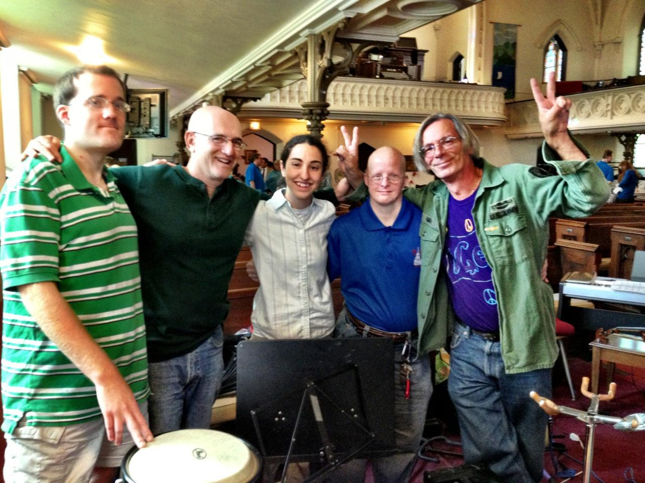
Seeking Good Form In Relationship & Support
Notes:
Brian is a person we support. Over the years we have listened to Brian through the lens of the different care and support models.
Describe Brian’s Journey.

Slide 20
Evolutionary Voices – Have We Been Selectively Listening?

Slide 22
Degrees of Individual Choice & Engagement
More
Marriage
Self-direction
Home ownership
Employment
Volunteering
Routine chores
←DEGREE OF ENGAGEMENT
Conditional health care
Personal care
Group Day Habilitation
Group home living
Sheltered work
Liability for Service
Eligibility Determination
Behavior management
Clinical Assessments
Fire Evacuation and Drills
Less
Offender management
Everyday transactions – e.g. Medicaid
Greater DEGREE OF Individual CHOICE/Individualization→

Slide 23
LADDER OF ENGAGEMENT
CO-DESIGNING
DOING WITH
ENGAGING
Towards Co-Creation & Partnership->
INFORMING/EDUCATING
Towards Complexity & Individualized Supports→
DOING FOR
COERCING
DOING TO

Slide 24
Levels of Individualized Supports – As Self-Direction Deepens – Our Roles and Relationships Change
Low – Working Within the Box of Legacy Services – Offering Menu Options
Medium – Taking the Box Apart – Redesigning and Reinvesting Legacy Services
High – Working Outside the Legacy Box – Co-creating with Individuals and Families

Slide 25
Diving Deep into the Blue Space – Innovating Social Arrangements from Care to Supports
Have You Paid Attention to Your Intentions? – Do You Use Self Awareness
As A Resource?- What are your assumptions about disability? Is your organization
Person-centered friendly?
Have You Gone to Places of Potential? What Have You Learned There That
May Contain a Kernel of Generative Possibility for Your Social Change Effort?
Have You Opened Yourself Up to Your Highest Purpose?
How Might You Connect to the Beloved Community?

Slide 26
Giving Birth to New Support Forms – Generating Prototypes
Re-engineering Regulations, Finances, Policies, Procedures and Other
Organizational and Funding Architecture to Sustain Evolving Supports
Designs
Co-Implementing New Supports Designs
Crystalizing and Co-Designing an Individualized Support Arrangement-
With Allies and Partners: Individuals, Families, Others.

Slide 27
Core Questions for Providers, Individuals with Disabilities, Families and Interested Others
What kind of outcomes are we intentionally seeking (for individuals with developmental disabilities)?
How does the workforce crisis impact service relationships in a delegated service environment?
What kind of relationships and roles (for providers, individuals and families) promote desired outcomes?
How in a context of increasing regulations, control, oversight, paperwork and cost cutting do we foster a container for partnership relationships to flourish when planning, designing and implementing supports?
How do we reshape our current agencies with deep investments in serving people in groups to supporting individuals in self-directed arrangements as citizens of their communities?
What are the personal capacities we need to develop to partner in co-designing supports with individuals and families?
Notes:
Making this shift away from delegated responsibility for services, supports and outcomes to shared co-created arrangements – the following questions are important to ask but may not be easy to answer.
They are posed as markers to get out attention – they are surfaced to get the conversation started.

Slide 28
Dimensions of a Authentic Person-Centered Role Orientation?
1. An asset-based approach: Does your service or support acknowledge and celebrate the assets of users and the community, rather than focusing on deficits?
2.Working on capabilities: Does your service or support build the skills of individuals?
3.Developing mutuality : Does your service or supports promote a true partnership and shared responsibility between professionals and users?
4.Growing networks: Does your service support, connect with, learn with, and reflect with individuals other than the usual suspects? Does your service provide forums for users and professionals to connect and share expertise?
5.Blurring roles: Do you view the people you support as crucial to managing support tasks?
6.Acting as catalysts: Are you provided with the opportunity to act as coaches and facilitators to the people you support?

