Slide 1
AHRC – NYC Hudson River Services (HRS)
Presentation October 2021

Slide 2
Our vision is to create rewarding employment opportunities for all people in our programs leading to long term success, personal satisfaction and economic self-sufficiency.

Slide 3
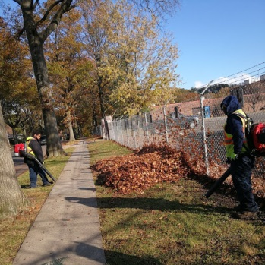
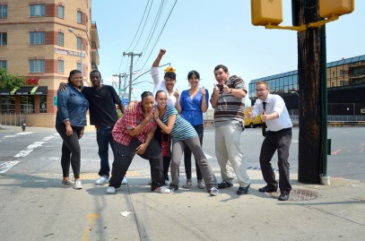
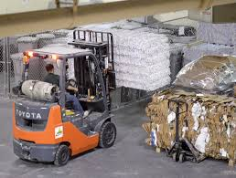
Individualized Approach to Employment. We offer career choices, variety of careers and customized supports. The final goal is to help individuals to become more independent, productive and work in inclusive environment, make friends and have natural supports!
Jobs, Jobs, Jobs for people with all Abilities and Interests!

Slide 4
CORE ON BUSINESS LINES & CUSTOMERS NYSID – ABILITY ONE – COMMERCIAL DEVELOPMENT PREFERRED SOURCE ALLOWS US TO GAIN EASIER ACCESS TO GOVERNMENT OPPORTUNITIES
Line of Business | Description | Some of the Customers
Janitorial Business: Commercial Government | Provide high quality janitorial services including some handymen services including hospital cleaning, office cleaning, and warehouses. From post-construction clean up to daily maintenance. | Staten Island Ferry Fire Department of New York Federal Bankruptcy Court MTA Department of Transportation Human Resources Administration AHRC NYC Facilities ETSY
Landscaping Business | Spring and Fall clean up, complete landscaping services for commercial and residential customers, pruning and more | Fire Department of New York MTA Bus Depots DMNA Armory – Staten Island Taxi and Limousine Commission OPWDD
Secure Document Destruction | Secure document destruction services- off site, AAA NAID Certified, Purges, Clean up after and before moving, shredding services consultation, community clean up events and paper recycling | Federal Customers Human Resources Administration NYC Board of Elections Brooklyn Hospital Richmond University Hospital AHRC NYC Facilities
Messenger Services | Foot and vehicle messenger services across five boroughs of NYC delivering sensitive mail to various establishments | Human Resources Administration NYC Hospitals Medicaid Offices across 5 boroughs
Snow Removal Services | Snow removal services for commercial customers including public parking lots and sidewalks. Plowing services, ice removal services, and more. | OPWDD Metropolitan Transit Authority Office for Children Services Department of Transportation

Slide 5
WHY CHOOSE AHRC- NYC HRS?
Average wage per hour $21.00
Career choices – occupational diversity
Retirement plan
Medical / Dental / Vision Insurance
Paid Time Off
Routine, structured schedules
Career choices
Job Coach support

Slide 6
Lanora works with HRS since 2013. She came through one of our programs- YAIP. She says her life changed for the better. It was first time she could afford a vacation and go see her cousin in Florida. She encourages anybody seeking a fresh start to consider YAIP with the hope of working with HRS. “I always tell my friends that you’re with people who are in the same position as you, and let’s be honest – finding work on your own hasn’t worked. I’m living proof. I did the 14 weeks and got a job.”

Slide 7
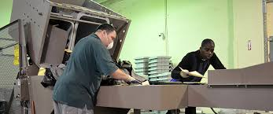
Our Secure Document Destruction Business provides opportunity for people who do not want to do janitorial work or need more supports to work in other areas. Just to name a few jobs: * Customer Service Assistant * Paper Sorter * Data Entry Specialist * Shredder Operator These jobs provide us opportunity to use individualized approach to employment based on person’s likes, dislikes and strengths.
ShredAbility

Slide 8
LANDSCAPING JOBS
For workers who like to move around, work outside and do something new ever day.
Easy machines to use and gaining transferable skills to use at other jobs
9 months a year that leaves time for other projects for 3 months
Average pay $17 per hour

Slide 9
Foot & Vehicle Messenger Jobs
Foot & Vehicle Messenger services between 5 boroughs of NYC
38 messengers working at various HRA locations delivering mail
Monday through Friday
9 am- 4 pm

Slide 10
James Walker, Winner of 2015 Joslin Outstanding Performer Award: “If I didn’t have this job, I would be hanging around in the street doing nothing, probably getting into trouble. I like being busy” (Works with American Maintenance at Westchester Community College).
James Walker, 50
Moderate Intellectual Disability
Seizure Disorder
Lived with family, attended day habilitation programs.
20 years ago joined EBS- he now works through HRS:
loves his job
lives in his own apartment
enjoy listening to gospel music and going to church when not working.
Has friends among co-workers who help him if he needs it and job coach is not around

Slide 11
Maggy Bottex, Winner of 2016 Outstanding Performer Award “I like to show other people what people with disabilities can do”(Works at OPD Clinic in Brooklyn)
BEFORE HRS:
Moved to NYC in 1996 from Haiti
Had undiagnosed DD/ID
No family supports
Homeless, lived in shelter
Relied on Food stamps
Attended Day Hab Program
NOW WITH HRS JOB:
Works with OPD, earn $25 per hour
Lives in her own apartment through ISS
Has Medicaid Service Coordinator
Loved by co-workers who have become friends
Does not look back
Earn her own money to pay for food and clothing

Slide 12
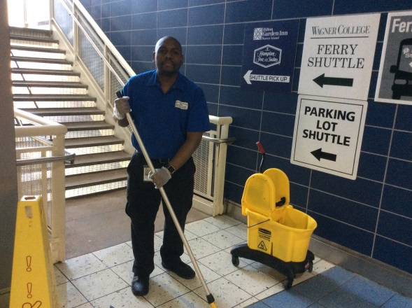
David Jackson, Joslin Outstanding Award Winner 2017 said “If I didn’t have a job with Hudson River Services, I would be still working at a grocery store and making minimum wage” (works at DOT Staten Island Ferry)
David Jackson, 50, Diagnosed with ID/DD
Born to 16 year old mom
Had sister with disability
No father
Before Working with HRS:
Attended Weingold workshop
Lived with mom and sister who had disability)
Enrolled into SEMP but had a job at a grocery store- not making enough
Lives with his fiancé in their own one bedroom apartment
Works at the Ferry- loved by co-workers, supervisors and recognized for the hard work
Goes for vacation with fiancé once a year to Puerto Rico where he is originally from

Slide 13
HOW DO I START A CAREER IN JANITORIAL SERVICES
Careers in Environmental Services— 16 week combination of virtual and in-person classroom, life skills, academic skills, work readiness preparation, on-site training, paid internships, graduating with the Cleaning Management Institute Certification, ages 18-24.
This is an opportunity to not only learn the in’s and out’s of the ever expanding and growing Janitorial field of work, but get hands-on training.
ENROLLING NOW!!!
Contact Marina Muratova
646-455-7772

Slide 14
AHRC NYC Queens Employment and Business Serivces
AHRC NYC Queens offers a variety of programs like:
Supported Employment (ACCES-VR), Supported Employment (OPWDD ), Pathway’s to Employment and Direct Placement Services
AHRC NYC Queens
Day Habilitation, Day Habilitation Without Walls (DHWOW), Respite, Community Habilitation, Travel Training Services and many more. For more information or to request services for you or a loved one, please call:
at Referral and Information Center at
212-780-4491
Email: referrals@ahrcnyc.org

Slide 15
Presenter contact information: Steve Towler AHRC-NYC VP Programs & Business Development Steve.towler@ahrcnyc.org 347-672-7013 Wayne Thomas
AHRC-NYC
Regional Operations Director
Employment and Business Services
Wayne.thomas@ahrcnyc.org
347-672-7022 For Program Contact and more information:
Melissa Levin
AHRC-NYC
Employment & Community Services Coordinator
Melissa.levin@ahrcnyc.org
917-664-6496

