Slide 1
New York START Region 4: Getting “STARTED”
Dr. Roslyn Burton-Robertson
Director
Tri-Borough
Nadine Wilches, LCSW
Clinical Director
Tri-Borough

Slide 2
The START Model
Systemic
Therapeutic
Assessment
Resource
Treatment

Slide 3
Systemic, Therapeutic, Assessment, Resources & Treatment (START)
The Center for START Services is a national initiative that strengthens efficiencies and service outcomes for individuals with intellectual/developmental disabilities and behavioral health needs in the community.
The START program model was implemented in 1988 by Dr. Joan Beasley and her team to provide community-based crisis intervention for individuals with IDD and mental health needs. It is a person-centered, solutions-focused approach that employs positive psychology and other evidence-based practice.

Slide 4
System Change Agents
"The measure of intelligence is the ability to change."
~ Einstein

Slide 5
Essential Components of the Model
Linkages
Expertise, training
Family support and education
Planned and emergency therapeutic resources (respite services)
Cross-systems crisis prevention and intervention planning
Employs evidence-informed practices and outcome measures (advisory council, clinical team, data analysis)
Learning communities, local, regional, statewide, national

Slide 6
Positive Psychology
(strength-based/ person-centered)
“We believe that persons who carry even the weightiest psychological burdens care about much more in their lives than just the relief of their suffering. Troubled persons want more satisfaction, contentment, and joy, not just less sadness and worry.”
Duckworth, Steen, & Seligman, 2005
Notes:
1. “build-what’s-strong” approach to therapy may usefully supplement the traditional “fix-what’s-wrong” approach
2. more serious consideration of those persons’ intact faculties, ambitions, positive life experiences, and strengths of character, and how those buffer against disorder.

Slide 7
The 3 A’s
Access ( timely, available)
Appropriateness (matches real needs, provides tools)
Accountability ( responsiveness, engaging, flexible, creative)

Slide 8
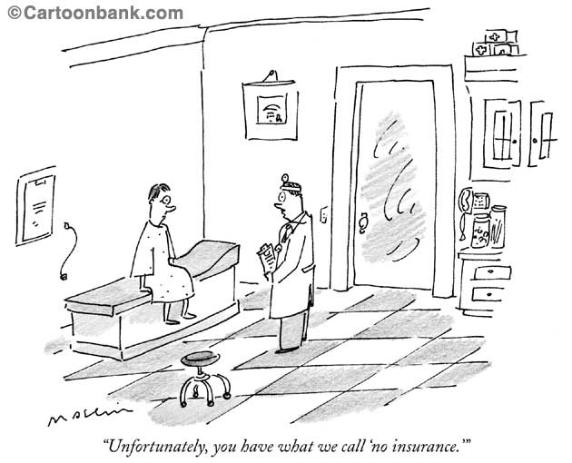
Access

Slide 9
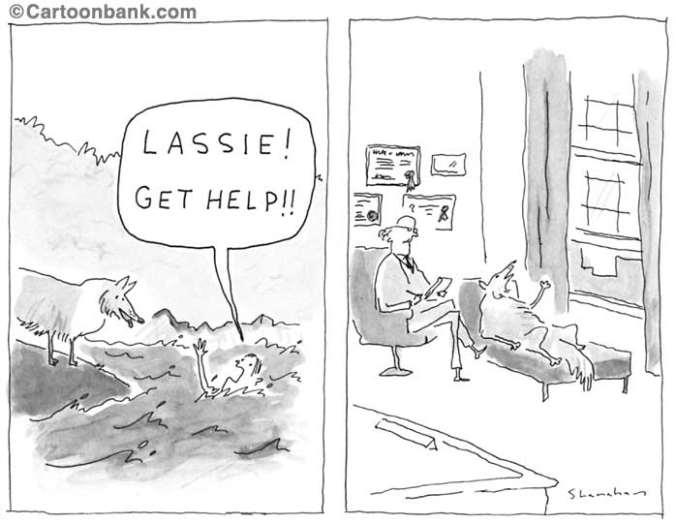
Appropriateness

Slide 10
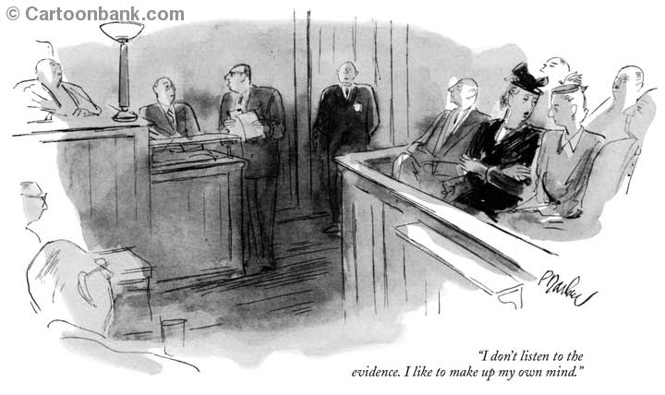
Accountability

Slide 11
Tertiary WHO Approach
Primary: Capacity building; communication and collaboration, improved quality services and quality of life; accountability
Secondary: Expertise, access to appropriate care, cross systems communication; crisis prevention; accountability
Tertiary: Expertise, appropriate response, stabilization, intervention; accountability

Slide 12
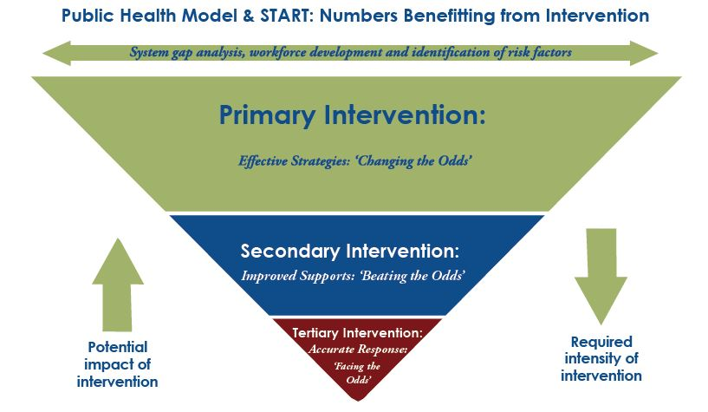

Slide 13
NYSTART
http://www.opwdd.ny.gov/ny-start/home
Who Qualifies?
“An OPWDD eligibility determination is required in order to receive the full array of NY START services”
Regional START Liaison: DDRO
http://www.opwdd.ny.gov/node/6017
How Do I Make a Referral?
A NYC START 24hr Crisis Number will be available upon rollout
Each DDRO Region has a crisis number.
NYC is DDRO Region 4

Slide 14
DDRO Region 4 NYSTART Contacts
Staten Island
Sonia Barton
(718) 982-1936
sonia.barton@opwdd.ny.gov
Brooklyn
Dr. Howard Reyer
(718) 642-8657
howard.reyer@opwdd.ny.gov
Bronx
Shanequa Mcintosh
(718) 430-0369
shanequa.mcintosh@opwdd.ny.gov Queens
Christina Antioco
(718) 217-5537
christina.antioco@opwdd.ny.gov
Manhattan
Samantha Sasley
(646) 766-3362
samantha.sasley@opwdd.ny.gov

Slide 15
START Clinical Services Team
Primary Intervention
Secondary Intervention
Tertiary Intervention

Slide 16
Primary Intervention/ Capacity Building
Professional Learning Community/Training
Access to experts in the field
Linkages
Reflective inquiry
Coaching/apprenticeship
Opportunities for learning
Shared values and norms
Development of common practices
Peer teaching
Evidence based analysis
Improved knowledge, access to care and services

Slide 17
Reflective Inquiry and Assessment
"If I had an hour to solve a problem I would spend 55 minutes thinking about the problem and 5 minutes thinking about the solution."
~ Einstein

Slide 18
START Secondary Intervention the tools of START
Certified Coordinators
Access to experts
Multimodal consult teams
CETs, START Plans, CSCPs, CSEs, SIRS, Systemic analysis
Study Groups across the country
PLCs
In home supports
Therapeutic Centers

Slide 19
CETs
Clinical Education for primary team and network
Case based
Expertise from MD and Clinical Director
Systemic analysis from START leadership
Can offer CEUs
Important collaborative monthly forum

Slide 20
Tertiary Intervention: 24 hour Community-Based Crisis Response
Integrated into the overall system, use a multidisciplinary team approach, and be able to communicate effectively; Working with inpatient units, mobile crisis teams, emergency rooms
Crisis Evaluation, Prevention, Intervention, and Stabilization: START Center
24 hour access to care providers for assistance within 2 hours
Discharge planning meetings within 24 hours with START Coordinators linked with in-home services, inpatient and START Resource Centers

Slide 21
START Resource Center-Based and Mobile Supports

Slide 22
Listening to Understand
"Time after time, I have found that when people are taken seriously, when they are respected, when their behavior is interpreted, understood and responded to accurately, when they are engaged in mutual dialogue rather than subjected to unilateral schemes of 'behavior management,' somehow as if miraculously, they become more ordinary. I know a number of people who have had severe reputations who have shed them when those supporting them listened more carefully."
Herb Lovett, Ph.D.

Slide 23
Short-Term Center-Based and Mobile Support Services
Diagnosis and treatment formulation
Positive psychology approach; health and wellness
Symptom monitoring
Emergency support
Hospital diversion
Community transition from hospital
Family support and education

Slide 24
Service at the Resource Center
Guest services include:
Planned site-based
Emergency site-based
Mobile in-home supports

Slide 25
The START Resource Center
4 Bedroom Home, Low-Sensory, Group Space
2 Crisis Beds
2 Planned Beds

Slide 26
Principle approaches to care at the Resource Center
“Guests”
Focus on positive psychology, positive characteristics from the time of admission and throughout the stay
Sensory reduction room for people with autism and others
All activities can be conducted in home
Trauma informed approach
Communication and collaboration with host home and providers
Data collection and assessment

Slide 27
A Typical Day at the Resource Center
Self-care/ADLs
Healthy eating
Exercise/Movement (at least 30 minutes/day)
Community experiences (4-7 days per week based on person-centered goals)
Giving back (Volunteerism)
Assistive technology or other communication devices are permitted.
Other technology is not permitted as it is believed to interfere with the therapeutic process and participation

Slide 28
Resource Center
Assessment and Collaboration
Occurs with partners throughout the day with close attention to the goals and objectives of the Center admission, clinical and treatment modifications, and communication with the individual’s family and primary team throughout the stay. Further, all community activities are designed to be easily replicated once the person returns home; they should not have associated excessive costs or planning aspects that will deter replication.

Slide 29
Emergency Site-Based
Crisis Stabilization (Up to 30 Days)
Safe environment
Linkages and collaboration/system’s support
Diagnostic clarification
Medication review
Psychological and social review
Assessment of problem
Structured programming
Hospital diversion, prevention

Slide 30
Planned Site-Based
Supports (3-5 days)
Keeping families together
Practicing new strategies
Transitioning from more restrictive settings
Developing new skills
Ongoing assessment to insure stability
Medication changes/modifications
Familiarity to insure safety net
Supporting families and systems in crisis

Slide 31
Differences Between Planned and Emergency
Scheduled vs. acute need
Length of stay
Who receives services
Why both are needed

Slide 32
Mobile In-Home Supports (Crisis)
Assistance in home at time of crisis
Works closely with START Coordinator and Clinical Director to define immediate goals and objectives
Does not replace existing support system enhances
Up to 72 hours

Slide 33
Mobile Supports (Planned)
Part of follow-up to prevent the need for crisis services
Skill building for provider
Outreach with START Coordinator to monitor and modify plans as needed
Support to implement PBSP and other plans
Transitional support after hospital or Center stay.
Training and consultation provided
Two to four hours a week
Can be scheduled to occur on a regular basis for up to one year as part of the START plan as needed

Slide 34
Q & A
What are your thoughts and questions?

Slide 35
Questions to Consider Collaboratively
How can we collaborate?
Who do you know that would be other good linkage partners for START in NYC?
What value can NYSTART offer the people you support?
What value can your program offer NYSTART?

